Slide 1



Slide 2

AI Based Inventory and Sales Optimizer
Supervised by:
Ms Sadia Ijaz
Group Members:
Adeel Ahmed (FA17-BCS-061)
Muhammad Haris (SP17-BCS-053)
Department of Computer Science
COMSATS University Islamabad, Attock Campus

Slide 3
Outline
Introduction
Problem Statement
Existing apps
Objectives
Functional Requirements
Benefits
Methodology
User Interface
Tools and Technology
Conclusion
Future Work
References

Slide 4
Introduction
“AI Based Inventory and Sales Optimizer” is an android app which will allow shop or warehouse owners to track the inventory status and keep an on eye on daily business activities and stats simply through their mobile phone.
Not only this but the main purpose behind the development of this app is to keep the inventory updated with the stock of the items which users are mostly buying and to forecast the amount of future sales of different items from time to time to keep the stock updated, through the use of ML and data mining algo’s.

Slide 5
Problem Statement
While proposing this idea we analyzed about the problems faced by the shop or small warehouse on daily basis to run their business in a smooth way. Because these people usually cannot afford a computer operator or hire any accountant who will be responsible to maintain the records of sales and manually review the inventory for running their business successfully.
So, for their assistance and to facilitate them from their smartphones our free app will a great helping hand for them to get rid of traditional or manual ways of running a business, which will ultimately save their time and money a well. Not only this but it will also help to optimize their sales and keep the inventory stock updated with the most selling products on the basis of smart AI suggestions.

Slide 6
Existing apps
Features | AI Based Inventory and Sales Optimizer | Stock Manager | Daily Sales Record | Store Manager
Products Details | ✔ | ✔ | ✔ | ✔
Product Type/Categories | ✔ | ✖ | ✖ | ✔
Customer/ Vendor Detail | ✔ | ✖ | ✔(only customers) | ✔(only customers)
Low Stock Alert | ✔ | ✖ | ✖ | ✔
Stats/Report | ✔ | ✔ | ✔ | ✔
Barcode Scanner | ✔ | ✖ | ✖ | ✔
Smart analysis | ✔ | ✖ | ✖ | ✖
Sales prediction | ✔ | ✖ | ✖ | ✖

Slide 7
Objectives
The main goals and objectives of our system are listed below;
Tracking all the products details and to visualize them by adding their picture or QR code.
Customizing and organizing each product in different categories for ease.
Updating the products record while selling or buying them by simply just scanning its barcode from the app.
To maintain and track all the records of vendors and customers.
Viewing and analysing sales reports and records on monthly basis.
Tracking and calculating profits or loss on monthly basis.

Slide 8
Objectives (continue)
To know about out of stock products or to check inventory status just on a button click.
Keeping different items in stock based on AI suggestions or future sales predictions through data mining algorithms.

Slide 9
Functional requirements
These are some of the functional requirements of our system;
Allows the user to signup on using the app for first time.
User can login into the app after signing up successfully.
Add inventory items with their details, and can also upload their image and barcode.
Customize the items on basis of different categories and brands.
Add customers and vendors details.
Update any item details by just simply scanning its barcode from the app during selling or purchasing it.
Review and update all the details of products, vendors and customers by simply filtering out on different factors.

Slide 10
Functional requirements (continue)
User can view and track all the stats and records of sales and purchase, profit and loss on different time period.
The system will update the user about real time stats of the products in his stock. Moreover, user can just check shortlisted items that are in low stock just on a button click.
Use of local or Google drive storage to backup valuable data of the user.
To predict or forecast the future sales of any product through the use of ML algorithms like ‘Neural network’ to keep the stock updated.
To know about the most selling products and the one which is often sold usually with the other products through the use of data mining algo’s.

Slide 11
Benefits
The foremost benefit will be to save time and money, over the traditional paper work system of running any business.
User can customize the items in different categories and can track amount of each item at any time with great ease.
Barcode scanning feature will help to save much time during selling or purchasing any items.
Reports and Stats are automatically generated without any hassle and can be viewed on daily, weekly and monthly basis.
AI is involved to analyse the user data to find out the most selling items.
User is also prompted about the future sales forecast of different items.
User data is saved as a backup on local or Google drive storage.

Slide 12
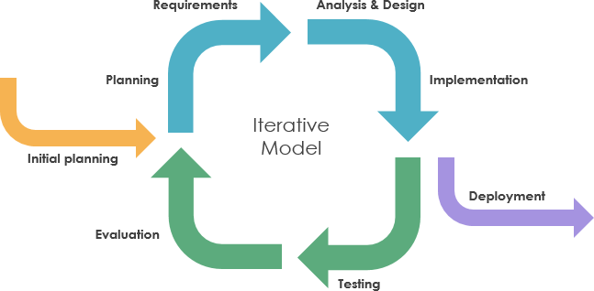
Methodology
We have used the "Iterative Approach" because we can distribute our goals and requirements in several chunks that can be incrementally implemented and delivered. At any stage, the plan is made just for the next increment and not for the whole project.
Therefore, we will be using the "Iterative Approach" due to its flexibility as it can easily accommodate any new requirements or changes in the current system. It also aids in improvement based on lessons learned from previous iterations. A basic flow process of the "Iterative Approach" is shown in the diagram below.

Slide 13
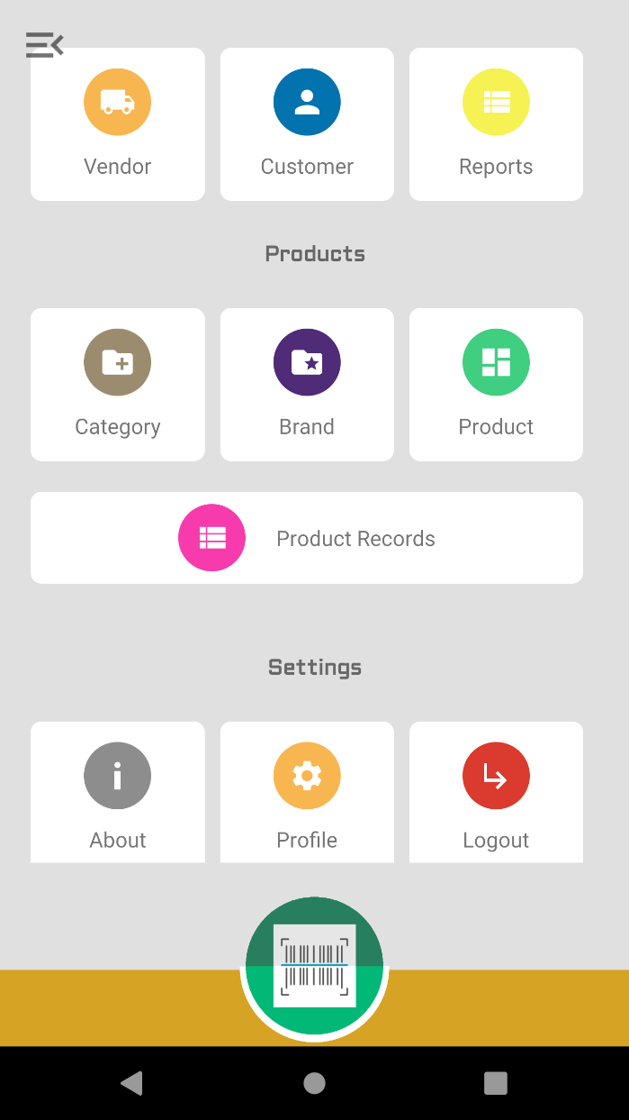
User Interface (Home Screen)

Slide 14
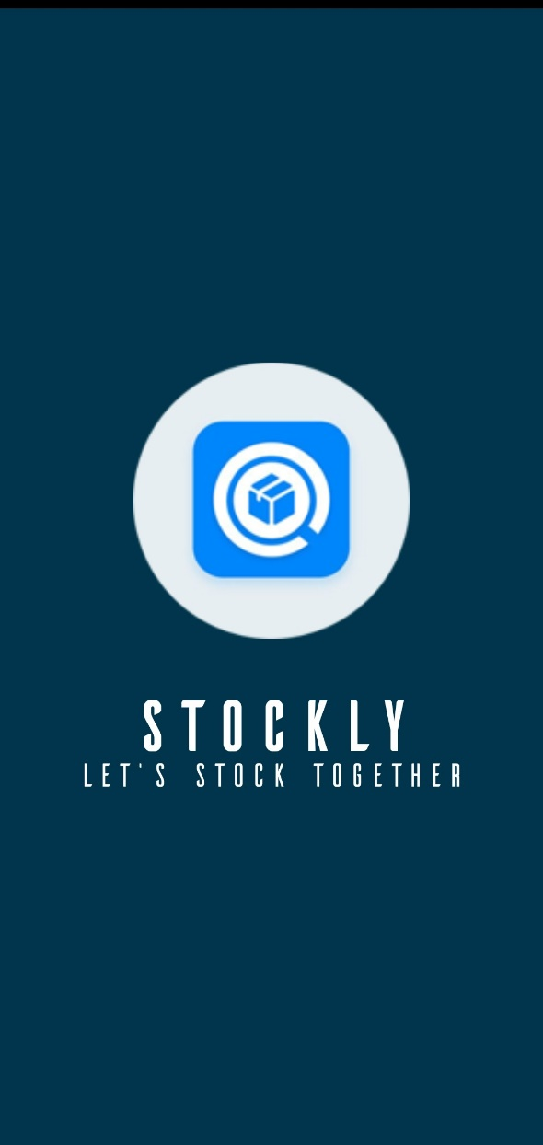
Splash Screen

Slide 15
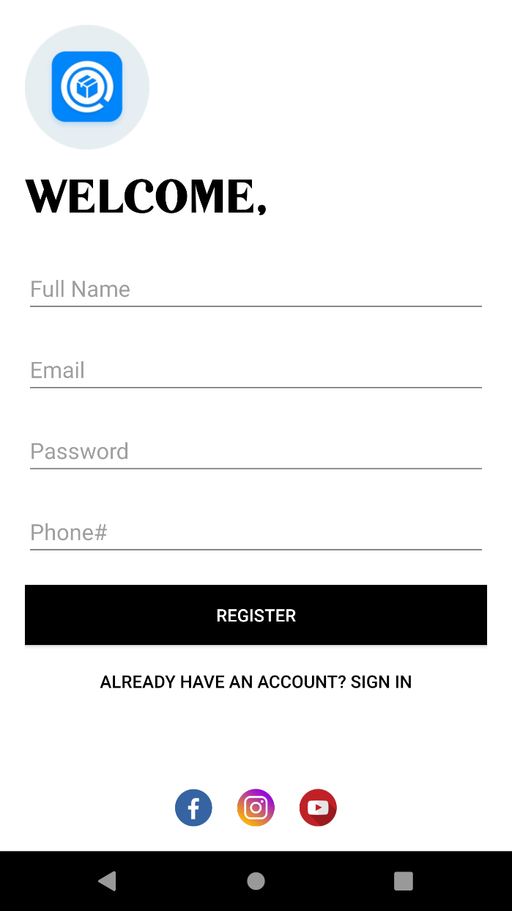
Signup page

Slide 16
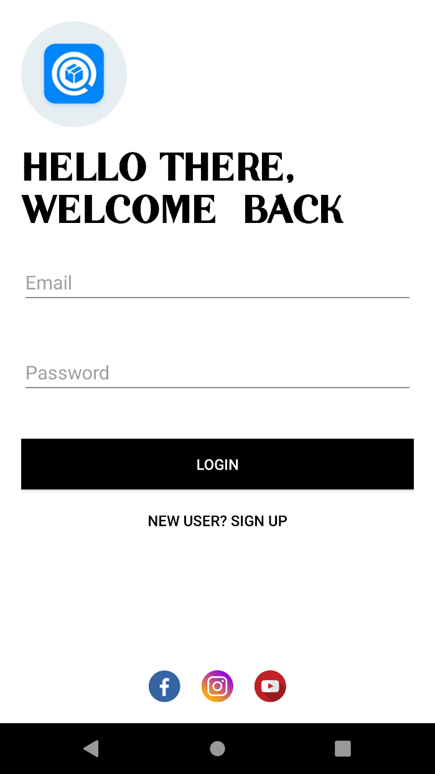
Login page

Slide 17
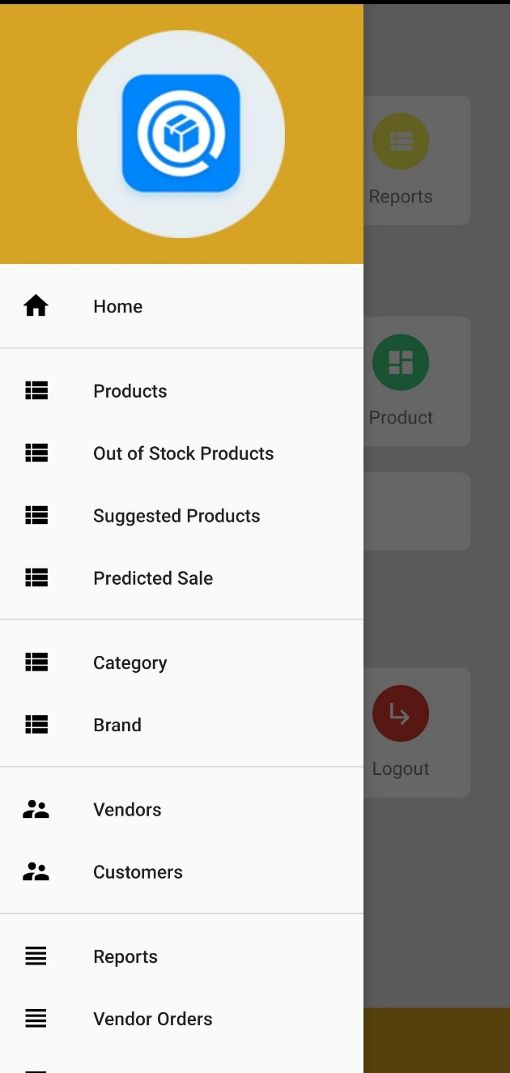
Navigation Drawer

Slide 18
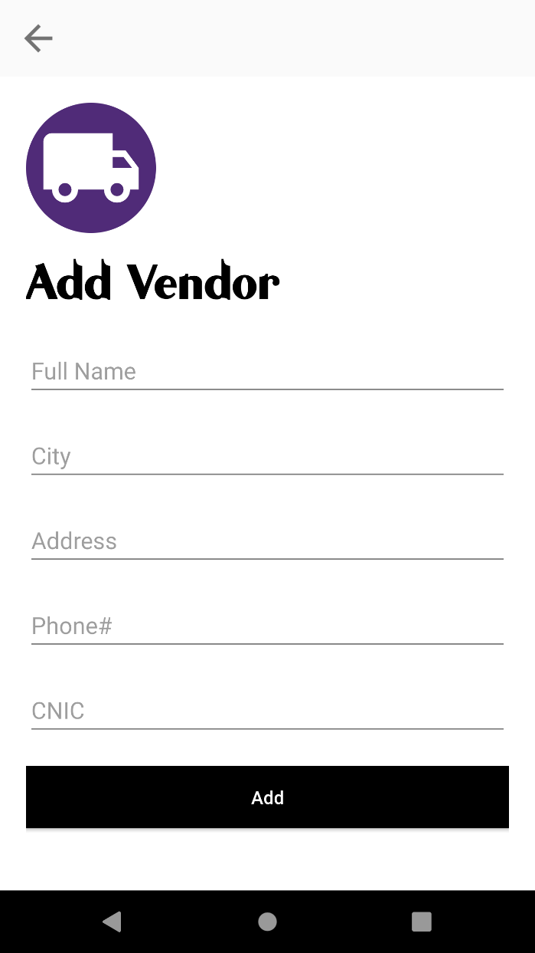
Add Vendor page

Slide 19
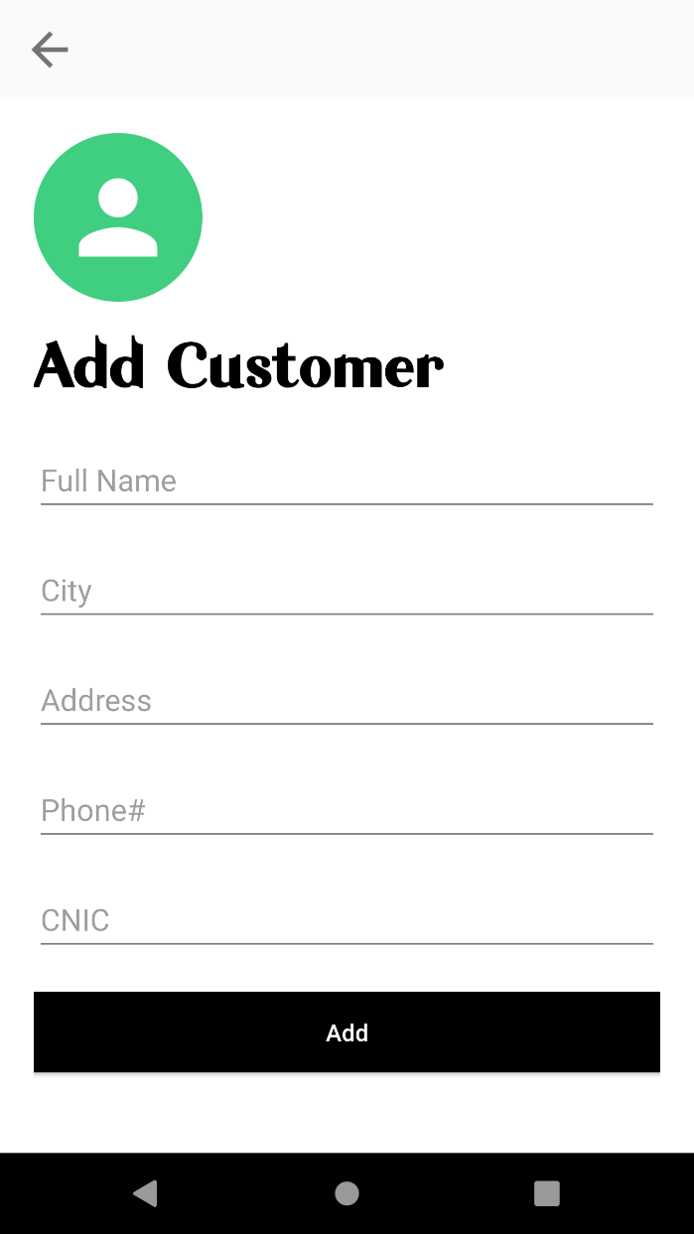
Add Customer page

Slide 20
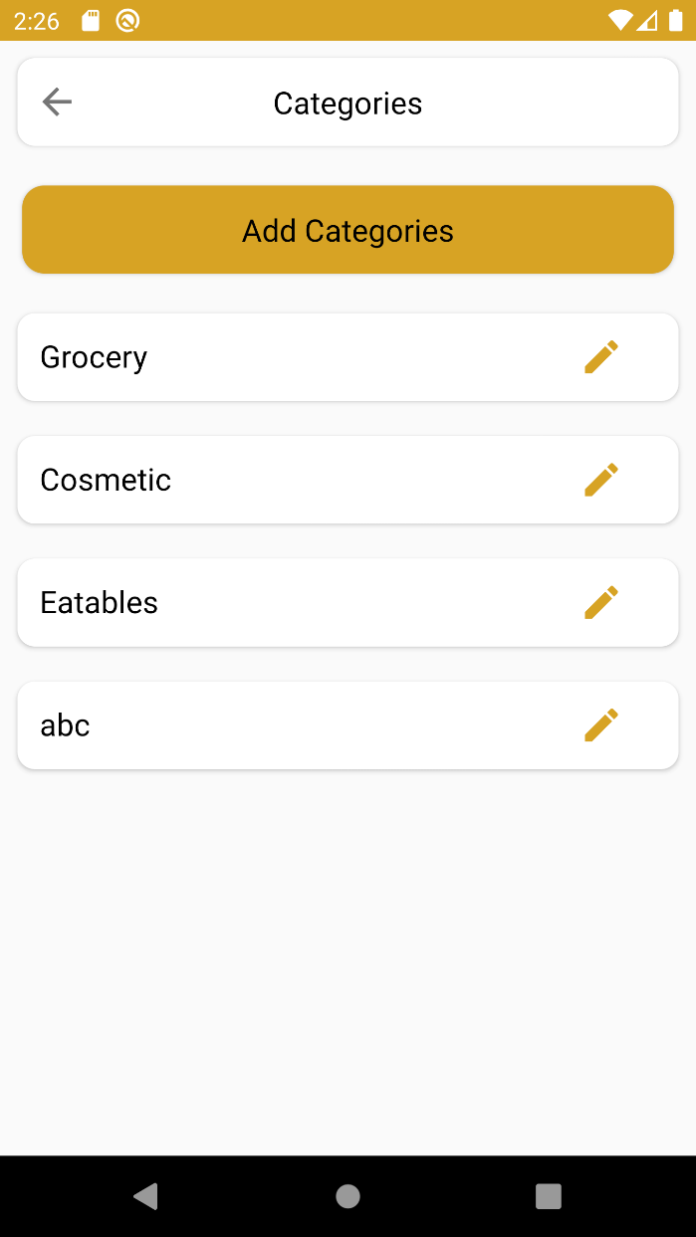
Add Product Category

Slide 21
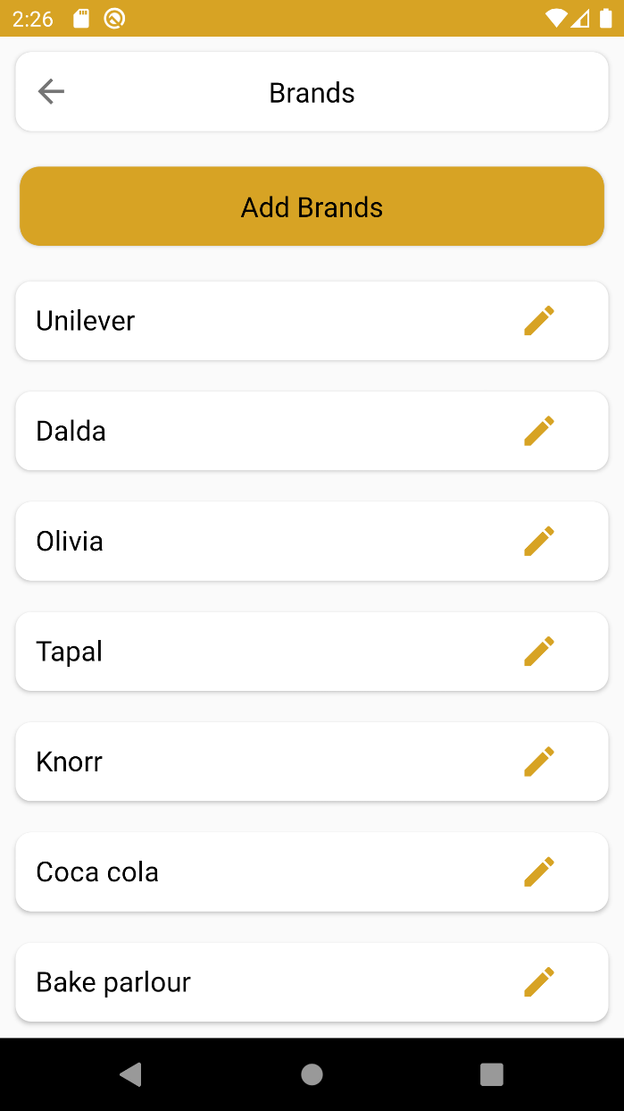
Add Product Brand

Slide 22
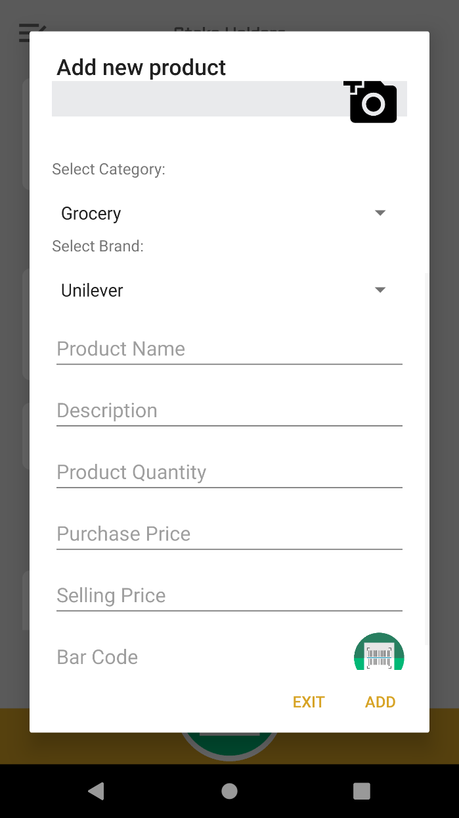
Add Product Info

Slide 23
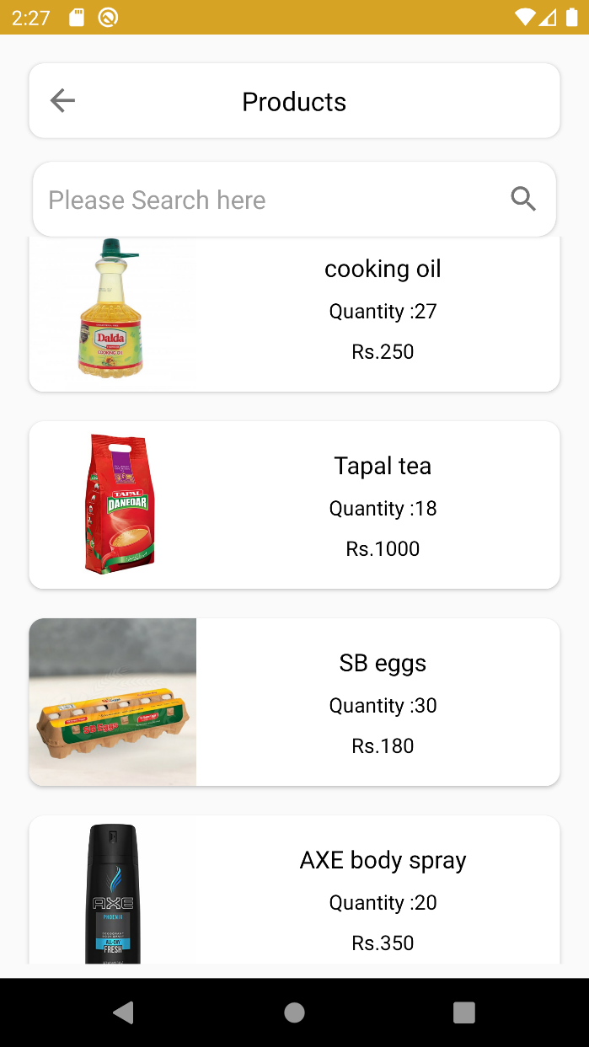
Stock Product Record

Slide 24
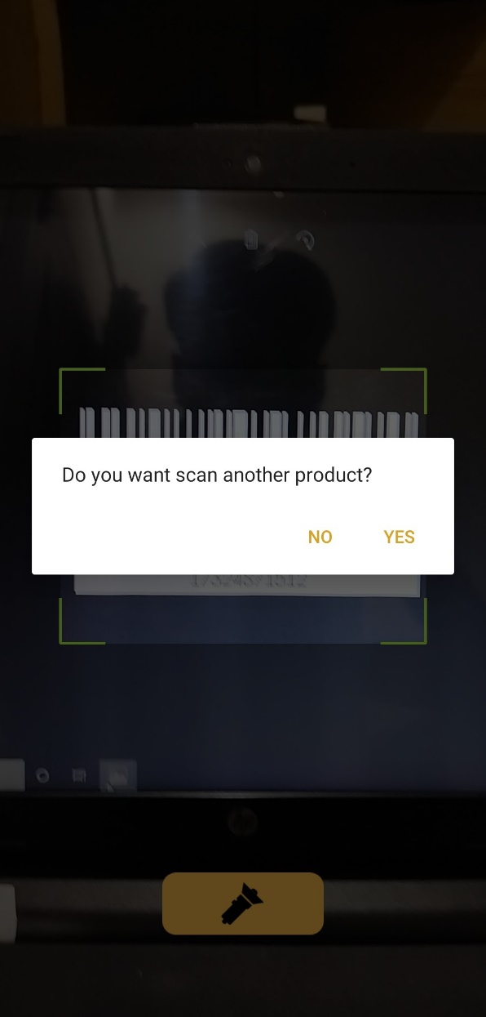
Barcode Scanner

Slide 25
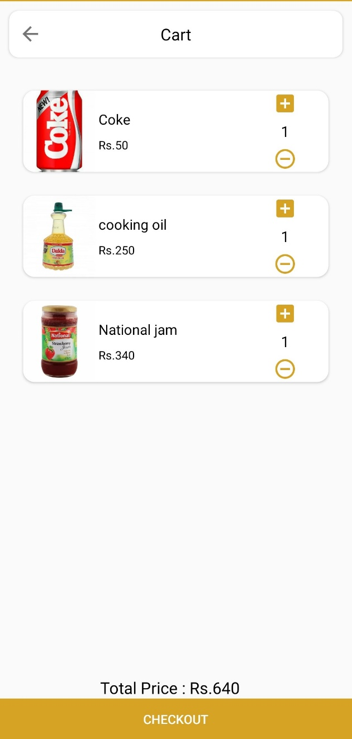
Cart Orders

Slide 26
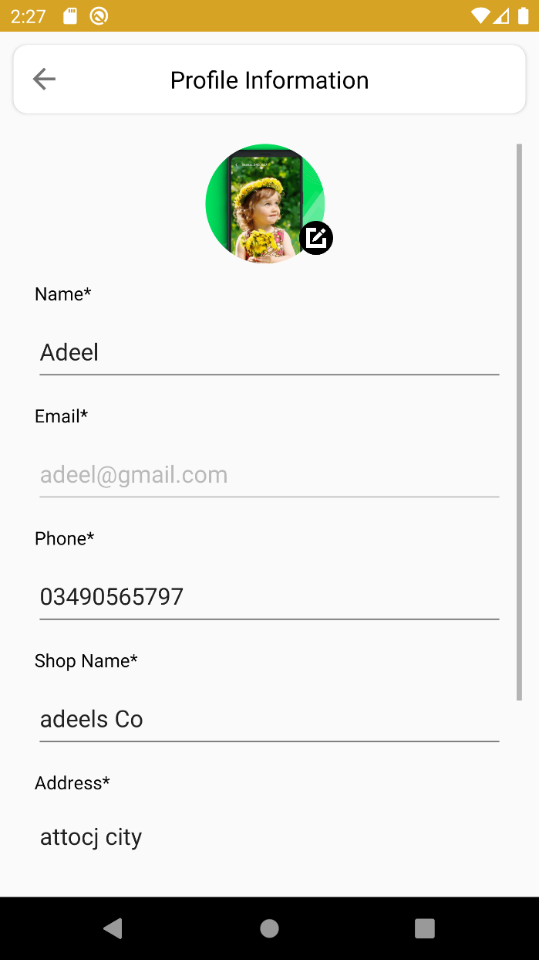
Owner Profile

Slide 27
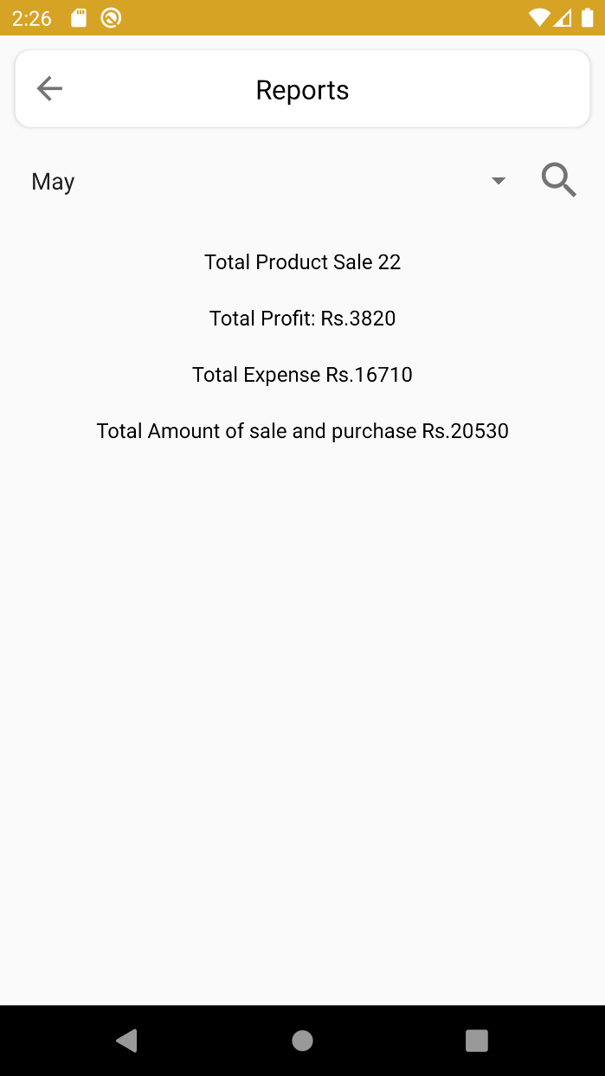
Sales Report page

Slide 28
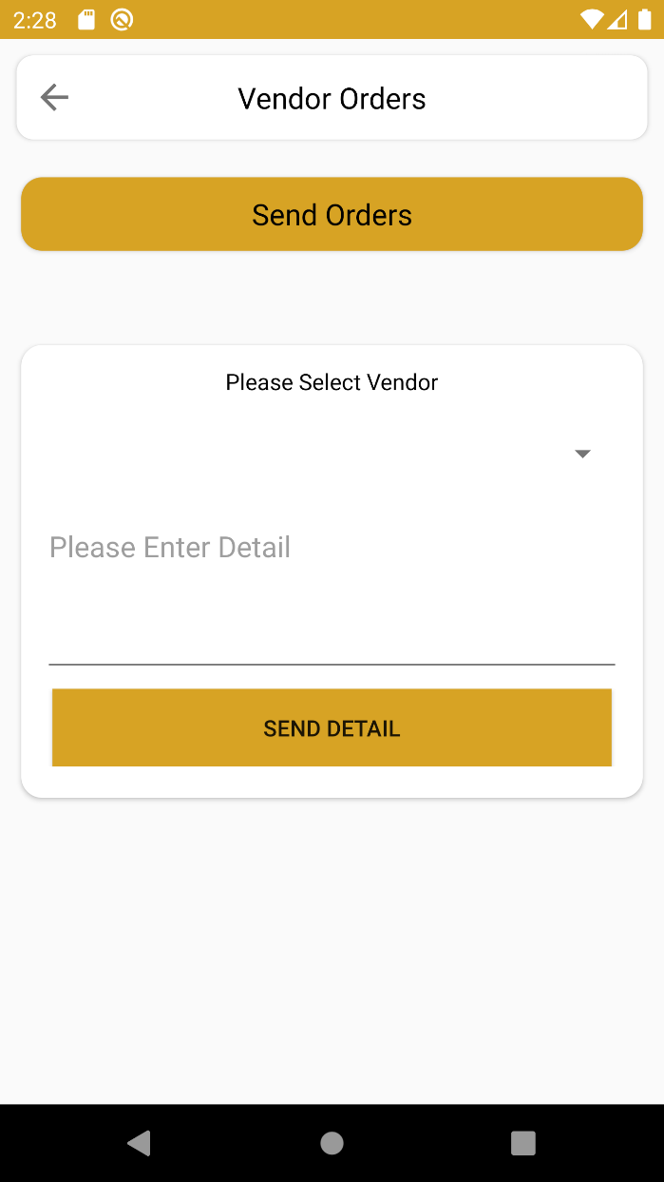
Vendors Orders

Slide 29
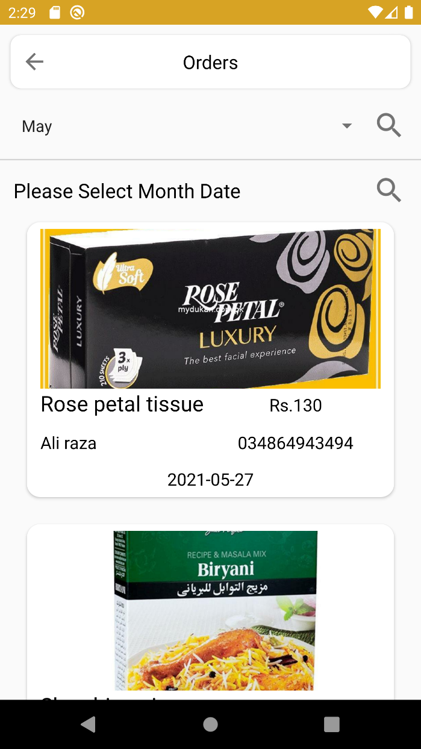
Customers Orders

Slide 30
Tools and Technologies
Tools & Technologies | Rationale
Java, PHP | Programming language
MS word | Documentation work
MS PowerPoint | Presentation work
Creately, Draw.io | Diagram work
Adobe Illustrator | App graphics
Android Studio | IDE
SQL Database | Backend work

Slide 31
Conclusion
“AI Based Inventory and Sales Optimizer” Android app will be a helping hand for shopkeepers or warehouse owners who will not be able to simply track and maintain a record of their daily sales or purchase activities, but also will be able to keep the inventory updated with the latest items which are mostly sold
This application will be best suitable to be used by shops or small-scale business owners because the system will overcome their daily routine problems which are being faced by these people during their work.

Slide 32
Future Work
There could be couple of changes possible in future which would make the system more efficient and more useful. Some of the planned future implementations are mentioned below,
Local payment gateways implantation within the app like Jazzcash.
The iOS platform version for this app may be planned in near future.
Publishing this app to popular app stores so max people can excess it across the globe.
Suggestions and recommendation algorithm to made more precise to accurately predict the products which are mostly sold out.
Customer module can be also considered to be an addition in current system

Slide 33
References
https://play.google.com/store/apps/details?id=com.kutirsoft.dailysalesrecord
https://play.google.com/store/apps/details?id=com.inventory.sales.invoice.fmcg.storemanager
https://play.google.com/store/apps/details?id=my.aahmetbas.stockcontroller

Slide 34
THANK YOU

